Slide 1


SMART MONITORING SYSTEM FOR SEWAGE WORKERS SAFETY
SRI KRISHNA COLLEGE OF ENGINEERING AND TECHNOLOGY, COIMBATORE
DEPARTMENT OF ELECTRONICS & COMMUNICATION ENGINEERING
Batch Members: Supervisor:
Reg No: 727721EUEC008 Name:AMIRTHA R Ms.VANITHA U ,Mtech.,PhD
Reg No: 727721EUEC017 Name:DEEPAKARTHIKA M
Reg No: 727721EUEC035 Name:GOKULMATHI P

Slide 2
Content
Introduction
Literature Review
Problem Statement
Objective
Existing Methodologies
Proposed Methodologies
Block Diagram
Hardware & Software Required
Conclusion
Future scope
References

Slide 3
Introduction
Sewage maintenance is a critical yet hazardous task that exposes workers to various risks, including toxic gases, physical strain, and confined spaces.
Ensuring the safety and well-being of sewage workers is paramount to prevent accidents and protect public health. Despite safety protocols and equipment, the inherent dangers associated with sewage work persist, underscoring the need for innovative solutions to enhance worker safety.

Slide 4
Literature Review
S.No | Title of the paper with details | Description | Merits | Limitations
1 | “IoT Device For Sewage Gas Monitoring And Alert System” -Nitin Asthana | This project aims at providing smart solutions to monitor poisonous sewage gases. | The proposed system will help sewage workers to protect their lives from risk. | There is no location services, tracking and modified alert system.
2 | “IoT based smart waste management system” -Anagha Gopi | This paper presents smart waste management using IoT based waste bin for collection and monitoring. | This detection helps in automatic opening and closing of the lid. | There is no safety measures for the scavengers.
3 | “IoT-based Automatic Manhole Observant for Sewage Worker’s Safety” -Rakesh Dronavalli | This aim to provide an automated manhole system that measures temperature, humidity, and harmful gases | If there is any abnormal change in the manhole,it transferred the messages to the stations. | There is no location tracking .
4 | “Smart Sewage System for Sewage Workers” -Ayush Kumar | It gives a warning message,if the level of dangerous gas exceeds the threshold. | It is cost effective and efficient. | Worker’s location is not included in the message.

Slide 5
Problem Statement
Sewage maintenance and inspection are crucial yet hazardous tasks, often involving exposure to toxic gases and strenuous working conditions.
The major problems that needs an solution:
Poor monitoring
No immediate actions
Lack of safety for workers
No location detection

Slide 6
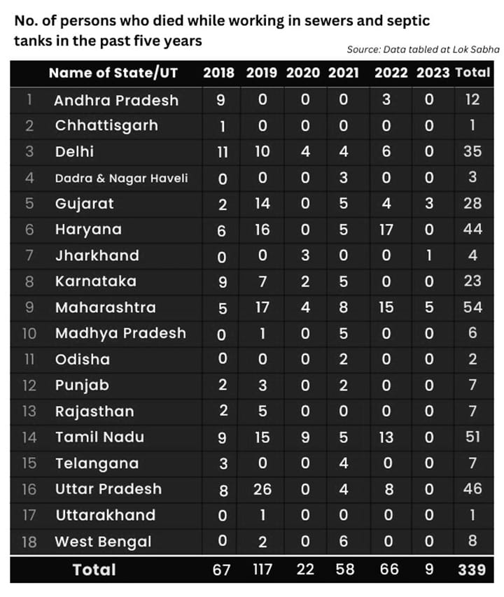

Slide 7
Objective
To mitigate risks and ensure the safety of sewage workers, this project proposes a Smart Monitoring System leveraging Internet of Things (IoT) technology.
The system integrates a NodeMCU microcontroller, gas sensor, pulse sensor, GPS module, and IoT connectivity to provide real-time monitoring and analysis of environmental conditions and worker health status.
The gas sensor detects harmful gases found in sewage environments, while the pulse sensor monitors the vital signs of workers, including heart rate and blood oxygen levels.

Slide 8
Existing Methodologies
Manual Inspection:
Disadvantages: Lack of real-time data makes it difficult to detect gas leaks promptly, increasing the risk of health hazards and environmental damage.
Fixed Gas Detectors:
Disadvantages: Installation and maintenance costs can be high, and the fixed nature of these detectors may not provide sufficient flexibility to adapt to changing conditions or expand coverage as needed.
Traditional Sensor Networks:
Disadvantages: Limited scalability and adaptability hinder the system's ability to accommodate evolving requirements or expand to new locations.

Slide 9
Proposed Methodologies
Smart Monitoring System:
Utilizes NodeMCU, gas sensor, pulse sensor, and GPS.
The NodeMCU microcontroller serves as the central processing unit, collecting data from the sensors and transmitting it to the cloud via IoT connectivity. The GPS module provides location data, enabling precise tracking of workers' movements within sewage systems.
Advantages:
Real-time monitoring.
Continuous hazard detection.
Immediate alerts for gas or health issues.
Enhanced worker safety.
Proactive risk management.
Cost-effective.
Scalable for different sewage systems.

Slide 10
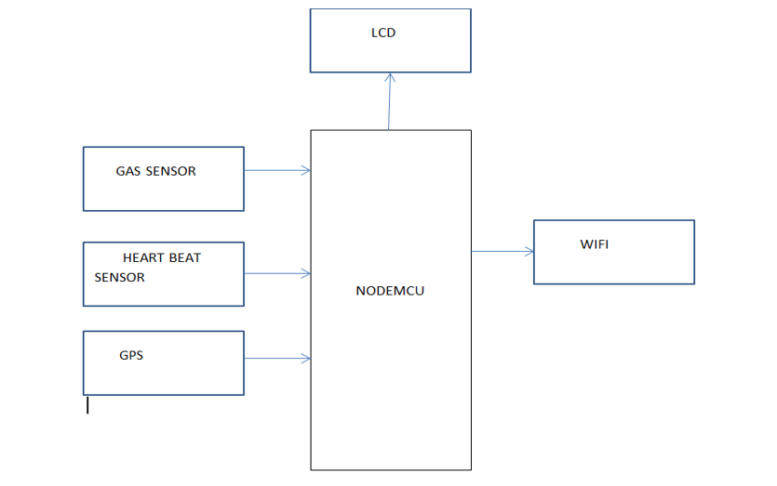
Block Diagram

Slide 11
Hardware required
NODE MCU
LCD
GAS SENSOR
HEART BEAT SENSOR
GPS MODULE

Slide 12
Software required
ARDUINO IDE
EMBEDDED C

Slide 13
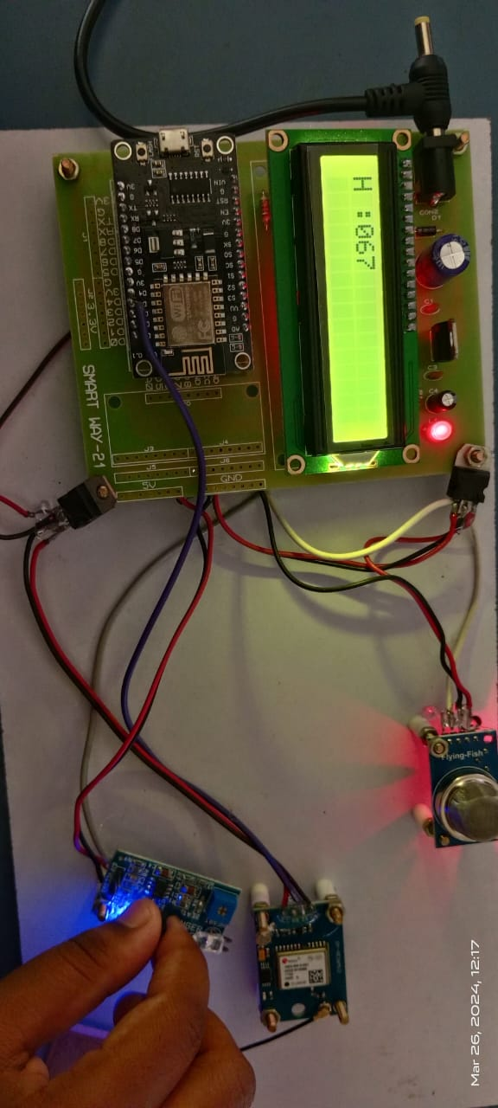
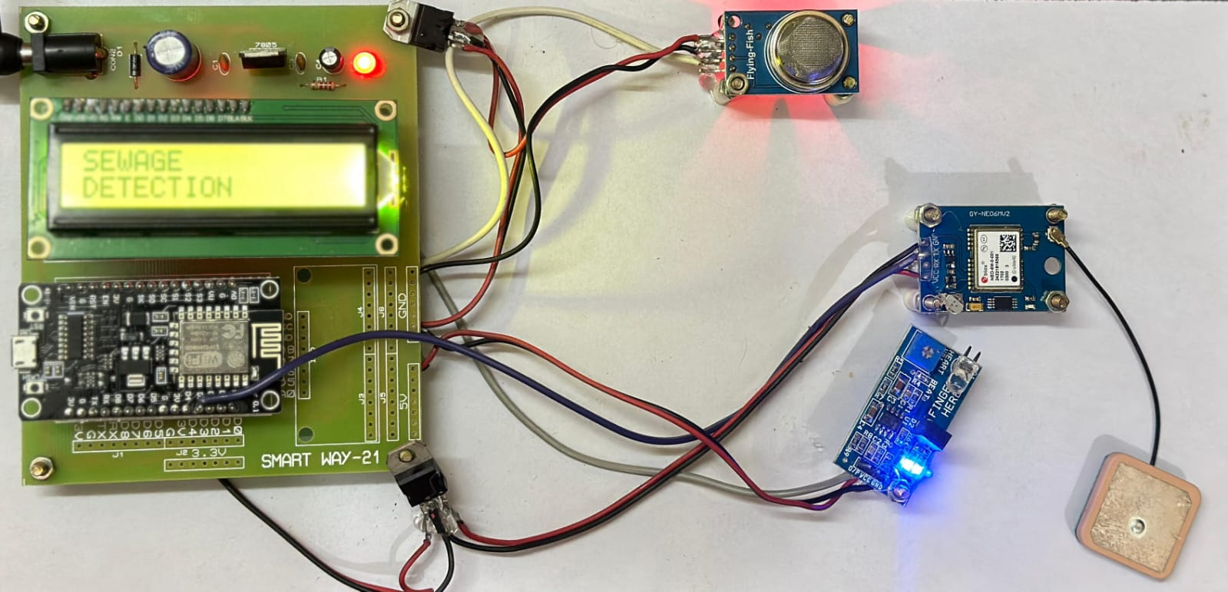
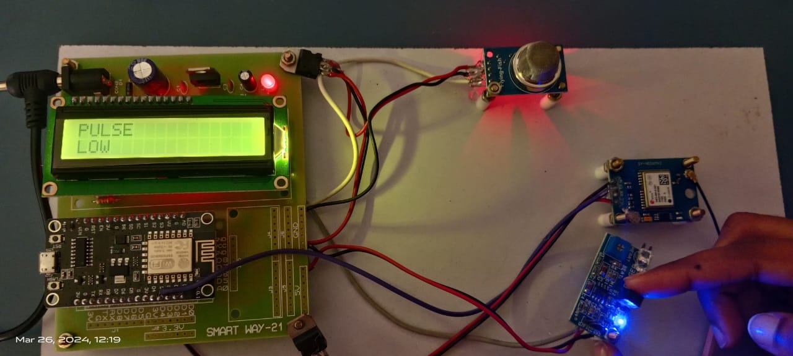
OUTPUT

Slide 14
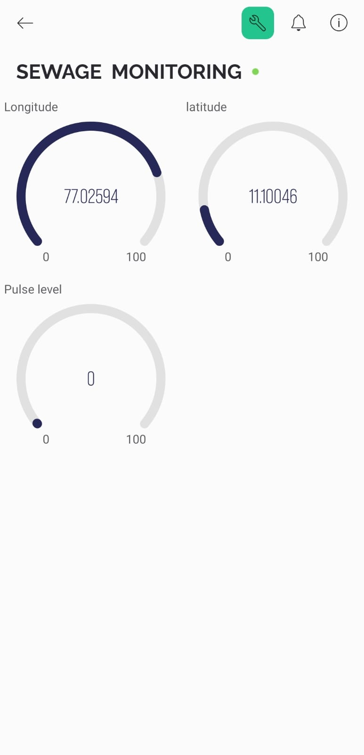
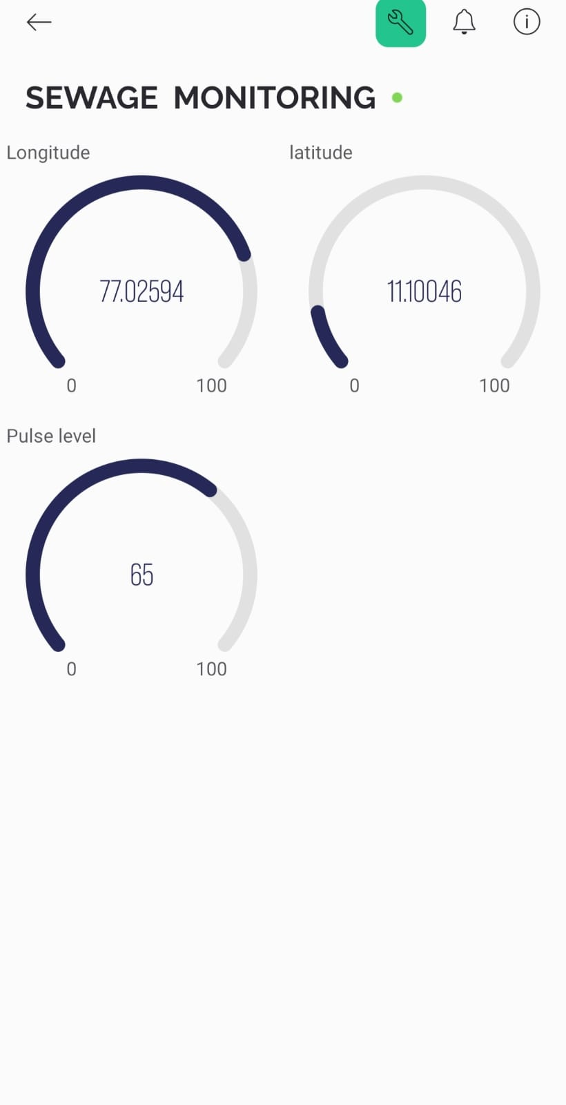
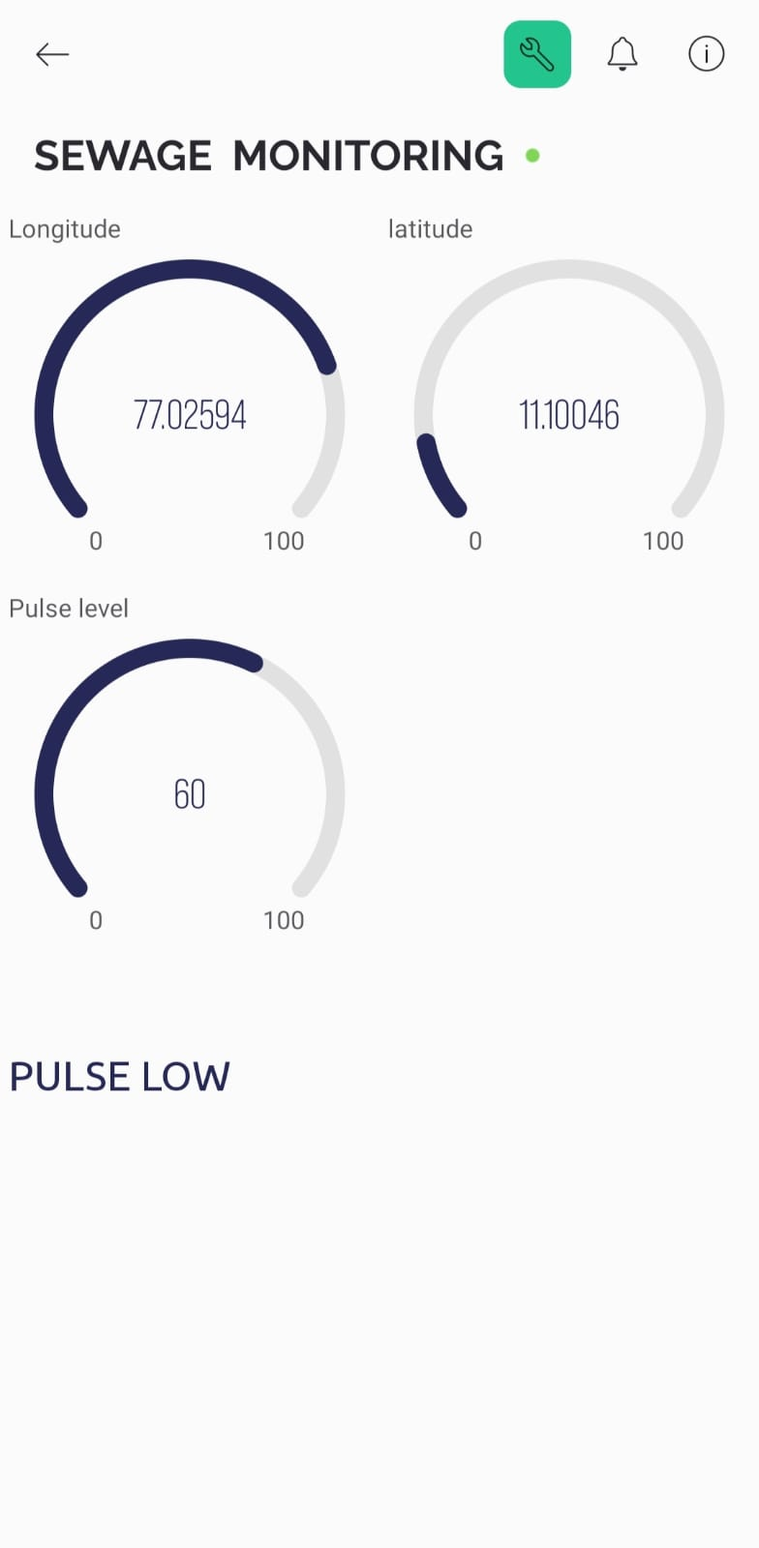
OUTPUT

Slide 15
CONCLUSION
The suggested practice aids in keeping society clean as well as preventing unexpected workplace accidents.
The smart safety gadget has a lower cost and gives an message.The suggested equipment aids the administration in gathering precise information about the number of harmful gases present in the sewage, if any.
At some point, the system will notify him/her of any threat to the employees. The smart device can be put into operation anywhere in the world and aids in monitoring sewage water overflows.

Slide 16
FUTURE SCOPE
Enhanced Sensor Capabilities
Predictive Analytics and Machine Learning
Wearable IoT Devices
Remote Monitoring and Control
Blockchain for Data Security

Slide 17
References
[1] KESHAMONI, K. AND HEMANTH, S. (2017).“SMART GAS LEVEL MONITORING, BOOKINGAMP;AMP; GAS LEAKAGE DETECTOR OVER IOT.”2017 IEEE 7TH INTERNATIONAL ADVANCE COM-PUTTING CONFERENCE (IACC), 330–332 (JAN).
[2] LIU, Z., WANG, Z., CHEN, R., AND WU, X. (2008). “INTELLIGENT RESIDENTIAL SECURITY ALARM AND REMOTE CONTROL SYSTEM BASED ON SINGLE CHIP COMPUTER.”2008 3RD IEEE CONFERENCE ON INDUSTRIAL ELECTRONICS AND APPLICATIONS, 159–161 (JUNE).
[3] MANNA, S., BHUNIA, S. S., AND MUKHERJEE, N. (2014). “VEHICULAR POLLUTION MONITORING USING IOT.”INTERNATIONAL CONFERENCE ON RECENT ADVANCES AND INNOVATIONS IN ENGINEERING (ICRAIE-2014), 1–5 (MAY).
[4] PEIJIANG, C. AND XUEHUA, J. (2008). “DESIGN AND IMPLEMENTATION OF REMOTE MONI-TORING SYSTEM BASED ON GSM.”2008 IEEE PACIFIC-ASIA WORKSHOP ON COMPUTATIONAL INTELLIGENCE AND INDUSTRIAL APPLICATION, VOL. 1, 678–681 (DEC).18
[5] RUSHIKESH, R. AND SIVAPPAGARI, C. M. R. (2015). “DEVELOPMENT OF IOT BASED VEHICULAR POLLUTION MONITORING SYSTEM.”2015 INTERNATIONAL CONFERENCE ON GREEN COMPUTING AND INTERNET OF THINGS (ICGCIOT), 779–783 (OCT).

Slide 18
Thank You

